Slide 1








YES WE
COMPUTER SCIENCE
XII - TERM-2 (2021-2022)
C O M P U T E R N E T W O R K S
S U R ES H BABU P
9787640719
PYTHON & SQL EXPERT

Slide 2
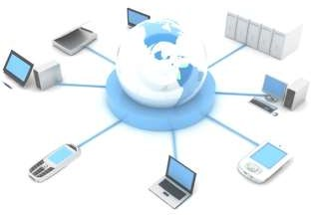


COMPUTER NETWORKS
A computer network is a set of nodes like computers and networking devices that are connected through communication for the purpose of communication and sharing resources (hardware/software) among the users.
Benefits of computer network:
•Facilitate communication through email/ video conferencing/ instant
messaging or any other mode.
•Share hardware devices like a printer or scanner
Enable file sharing
•Share software or operating programs
Share information
Disadvantages of computer network:
Lack of robustness, security issue, cost of network
S U R E S H
, 9787640719
Y E S
W E
C S

Slide 3
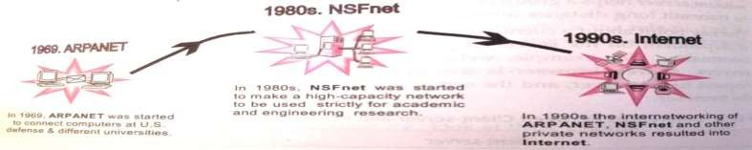
EVOLUTION OF COMPUTER NETWORKS
ARPANET (Advanced Research Projects Agency NETwork): In1969,TheUS govt. formed an agency named ARPANET to connect computers at various universities and defense agencies. The main objective of ARPANET was to develop a network that could continue to function efficiently even in the event of a nuclear attack.
Internet (INTERconnection NETwork): The Internet is a world wide network of computer networks. It is not owned by anybody. The internet has evolved from ARPANET. services are instantly available through internet: Email, Web-enabled audio/video conferencing services, Online movies and gaming, Data transfer/file- sharing, Instant messaging, Internet forums, Social networking, Online shopping, Financial services
Inter space: is a client/server software program that allows multiple users to communicate online with real–time audio, video and text chat in dynamic 3D environments.
S U R E S H
, 9787640719
Y E S
W E
C S

Slide 4
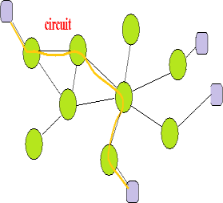
SWITCHING TECHNIQUES
Switching Techniques: Switching techniques are used for transmitting data across networks. Different ways of sending data across the network are:
Circuit Switching:
First the complete end-to-end transmission path is established between the source and the destination computers.
Then the message is transmitted through the path.
The main advantage of this technique is guaranteed delivery of the message.
Mostly used for voice communication.
S U R E S H
, 9787640719
Y E S
W E
C S

Slide 5
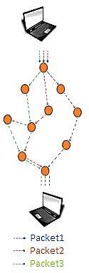
SWITCHING TECHNIQUES
Packet Switching:
Using the TCP protocol a single large message is divided into a sequence of
packets of size limits from 128 to 4096 bytes.
Each packet is independent and has the address of Sender and destination.
The IP (Internet protocol) does the routing for the packets. It keeps track of all the different routes available to the
destination. If one route is not available it finds the
alternate route to the destination.
At the destination, the TCP protocol re-assembles the
packets into the complete message.
If any packets are lost or damaged, a request is sent
to retransmit the same message.
S U R E S H
, 9787640719
Y E S
W E
C S

Slide 6
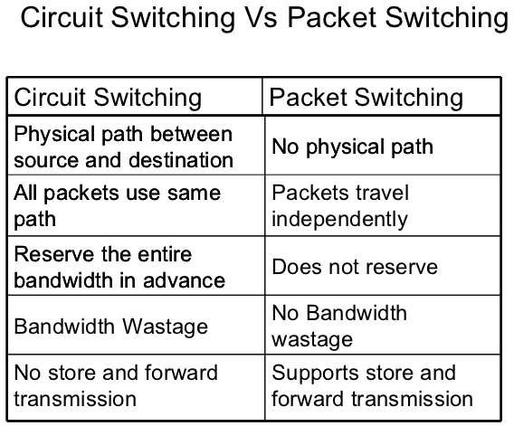
S U R E S H
, 9787640719
Y E S
W E
C S

Slide 7
Data Communication Terminologies
Channel/Medium: A channel is a separate path through which signals can flow.
Bandwidth: Bandwidth refers to the amount of information that can be transmitted over a network in a given amount of time, usually expressed in bits per second or bps.
Data Transfer Rate: The data transfer rate of a computer network connection is
normally measured in units of bits per second (bps).
Larger units are Kbps, Mbps and Gbps, KBps, MBps,GBps
bps means bit per second.
Bps means Byte per second
1 kilobit per second (Kbps) = 1000 bits per second (bps)
1 megabit per second (Mbps) = 1000 Kbps or 10002 bps.
1 gigabit per second (Gbps) = 1000 Mbps
1 Terabit per second (Tbps) = 1000 Gbps.
S U R E S H
, 9787640719
Y E S
W E
C S

Slide 8
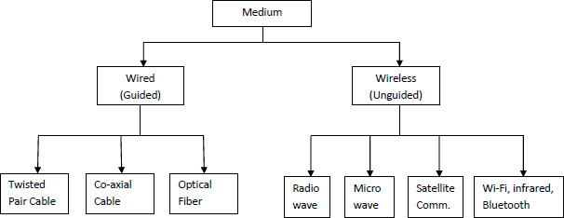
TRANSMISSION CHANNEL/MEDIUM
Channel/Medium:
A channel is a separate path through which signals can flow.
A channel has a certain capacity for transmitting information, often measured by its bandwidth in Hz or data rate in bits per second.
S U R E S H
, 9787640719
Y E S
W E
C S

Slide 9
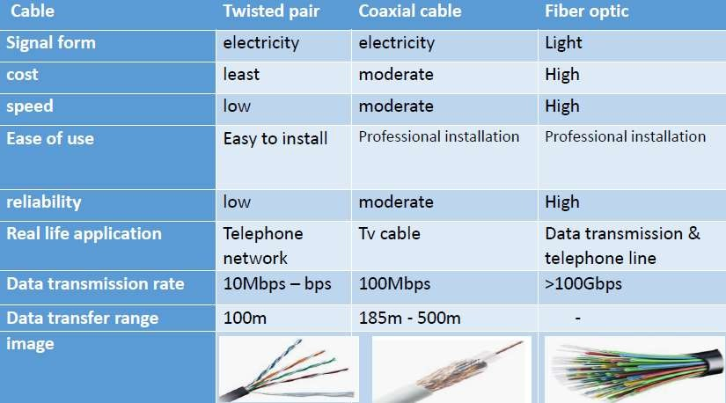
GUIDED MEDIA (WIRED CONNECTION)
S U R E S H
, 9787640719
Y E S
W E
C S

Slide 10
UNGUIDED MEDIA (WIRELESS CONNECTION)
Wireless Networks–It uses high-frequency radio waves rather than wires to communicate. Wireless allows for devices to be shared without networking cable which increases mobility but decreases range.
Infrared Wave Transmission-Short Range Communication: Infrared waves can travel from a few centimeters to several meters (Approx.5m). Line of Sight Propagation: Infrared uses point to point communication, both transmitter and receiver should be placed in line of sight of each other and there should not be any obstacle in between. Cannot Penetrate Solid object. It is Inexpensive mode of Communication. Secure: At a time only two devices can communicate therefore information passed to one device is not leaked to another device.
Radio Wave Transmission:-Long Range Communication: Radio waves can cover distances ranging from a few meters (in walkie-talkies) upto covering an entire city. Omni-directional: Radio waves are propagated in all directions. Therefore sending and receiving antennas do not have to be aligned. Penetrates Solid Objects. Inexpensive mode of communication. Radio wave communication is insecure communication.
S U R E S H
, 9787640719
Y E S
W E
C S

Slide 11
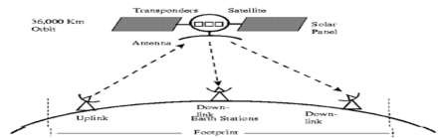
UNGUIDED MEDIA (WIRELESS CONNECTION)
Microwave radio, a form of radio transmission that use. Ultra-high frequencies. It is a point-to-point, rather than a broadcast, transmission system. Additionally, each antenna must be with in line of sight of the next antenna. Frequency Bands Maximum Antenna Separation Analog/Digital 4-6 GHz32-48km Analog 10-12 GHz 16-24 km Digital 18-23 GHz8-11km Digital.
Satellite Communication It provide world wide coverage independent to population density. Satellite communication Systems offer telecommunication (Satellite Phones), positioning and navigation(GPS), broad casting, internet, Mobile, TV, etc.
It support Very Long Range Communication with Line of Sight Propagation. It
Cannot Penetrate Solid Objects. It is Very Expensive communication mode.
S U R E S H
, 9787640719
Y E S
W E
C S

Slide 12


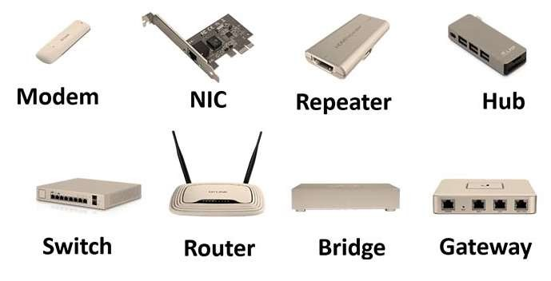







NETWORK DEVICES
Computer hardware devices which are used to connect computers, printers, or any other electronic device to a computer network are called network devices. These devices transfer data in a fast, secure and correct way with some specific functionality over same or different networks.
Modem
Hub
Switch
Gateway
Bridge
Router
Repeater
NIC (Network Interface Card)
RJ45 Connector
S U R E S H
, 9787640719
Y E S
W E
C S

Slide 13
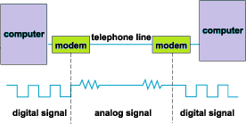
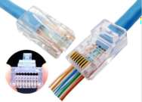
NETWORK DEVICES
Modem - Modulator Demodulator
It’s an electronic device used to access the Internet that modulates carrier waves to encode information to be transmitted and also demodulates incoming carrier waves to decode the information they carry.
Modulation means digital to analog signal conversion and its vice versa is known
as demodulation.
RJ45 Connector (Registered Jack–45)
It is an eight wired connector that is used to connect
computers on a local area network (LAN), especially Ethernet.
S U R E S H
, 9787640719
Y E S
W E
C S

Slide 14
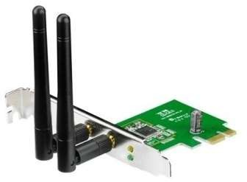
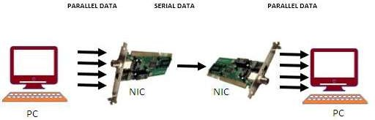
NETWORK DEVICES
NIC - Network Interface Card
This is at top among other networking devices and mostly
used networking device.
This is also known as network adapter card, Ethernet Card
and LAN card.
It allows our PC to communicate with other PCs.
A PC uses parallel data transmission to transmit data between its internal parts where as the media that connects this PC with other device/PCs uses serial data transmission.
A NIC converts parallel data stream into serial data stream
and vice versa.
S U R E S H
, 9787640719
Y E S
W E
C S

Slide 15
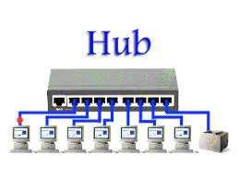
NETWORK DEVICES
H
HUB is used to connect multiple computers in a single LAN network of one work
group.
Generally HUBs are available with 4,8,12,24,48 ports.
When a hub receives signal on its port, it repeats the signal and forwards that
signal from all ports except the port on which the signal arrived.
There are two types of HUB
Passive HUB:-It only forwards the signal on all ports without amplifying the signal.
Active HUB:-it forwards the signal with improvement in the quality of data signal by amplifying it. That why such hubs need additional power supply.
S U R E S H
, 9787640719
Y E S
W E
C S

Slide 16
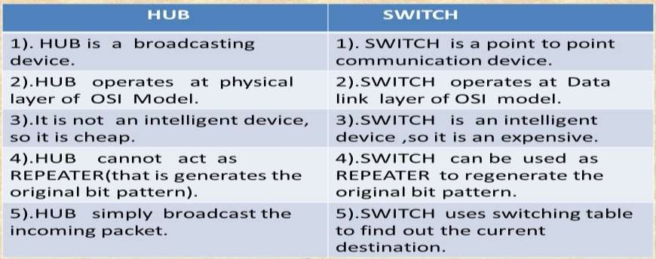
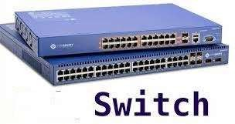
NETWORK DEVICES
Switch is also used to connect multiple computers together in a LAN work group,
just like hub.
Switches are available with 4,8,12,24,48,64 ports.
Switch makes their switching decisions by using application specific integrated
circuits(ASICs).
Due to switching decision capability, switch sends signal to recipient only and that’s
why switches are called as intelligent hub.
S U R E S H
, 9787640719
Y E S
W E
C S

Slide 17
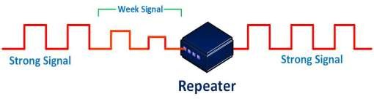
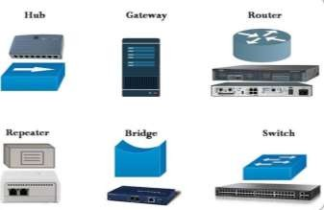
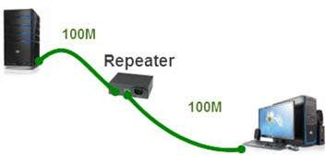
NETWORK DEVICES
REPEATER:
In a network signal travels a long distance in transmission media.
Due to resistance of media signal becomes weak.
Repeater is a networking device which regenerates the signal and forwards these
signal with more power.
S U R E S H
, 9787640719
Y E S
W E
C S

Slide 18
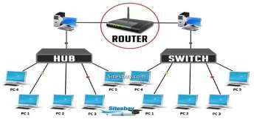
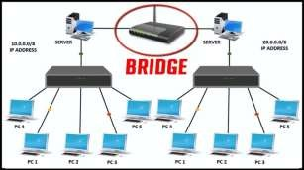
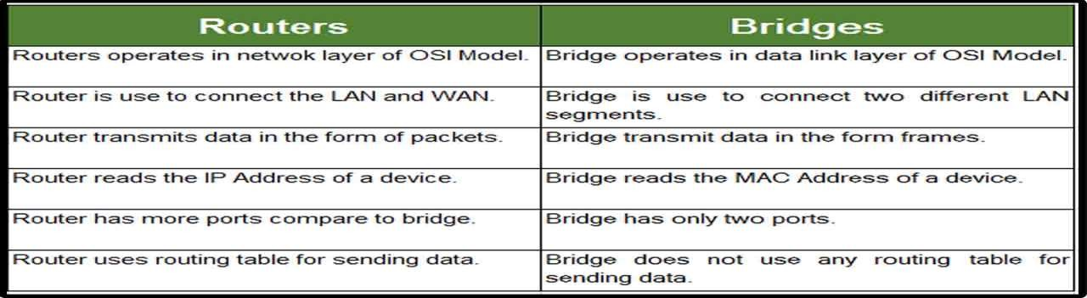
NETWORK DEVICES
S U R E S H
, 9787640719
Y E S
W E
C S

Slide 19
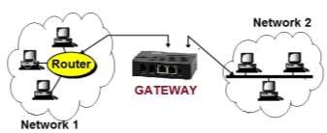
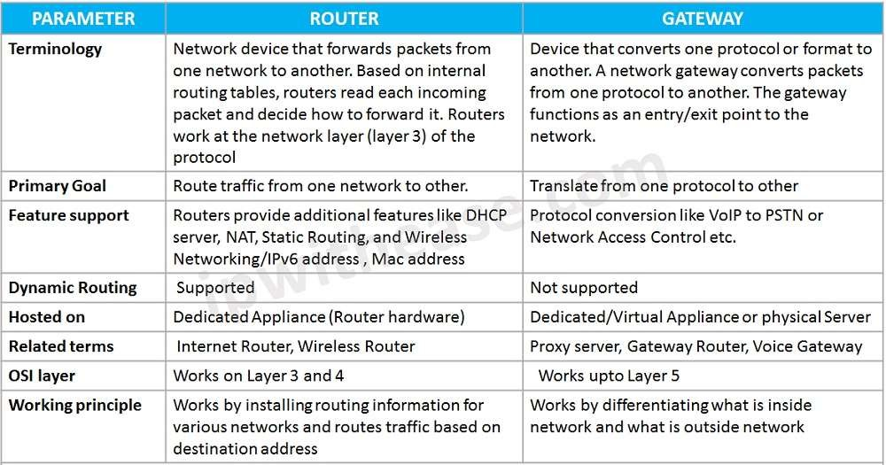
NETWORK DEVICES
Gateway
A networking device capable to convert protocols so that two different network architecture based system can communicate with each other.
It works as protocol convertor.
S U R E S H
, 9787640719
Y E S
W E
C S

Slide 20
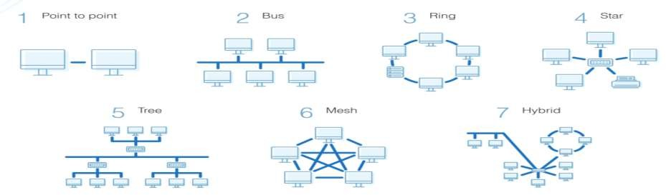
NETWORK TOPOLOGY
Structure of a network- The geometrical arrangement of computer resources, network devices along with communication channel is known as Network structure or Network topology.
Topology can be physical or logical
Physical Topology-physical layout of nodes and cables in the network.
Logical topology - the way information flows between different components.
Types of Physical Network Topologies
S U R E S H
, 9787640719
Y E S
W E
C S

Slide 21
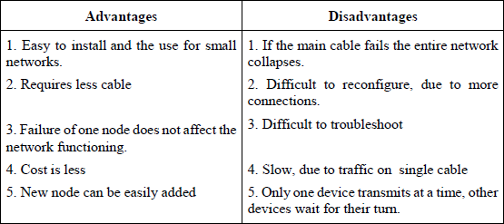
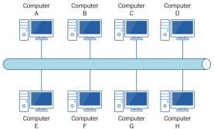
NETWORK TOPOLOGY
The following factors are considered while selecting a topology:
Cost
Reliability
Scalability
Bandwidth capacity
Ease of installation
Ease of troubleshooting
Delay involved in routing information from one node to another.
BUS TOPOLOGY:
S U R E S H
, 9787640719
Y E S
W E
C S

Slide 22
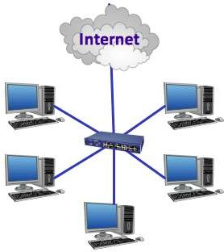
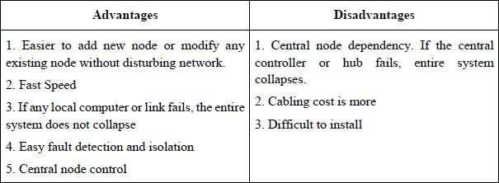
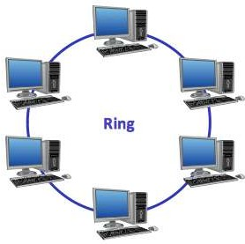
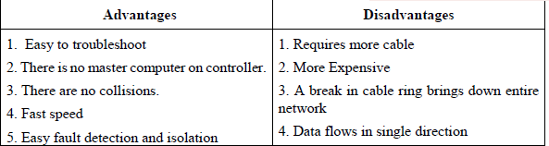
NETWORK TOPOLOGY
STAR TOPOLOGY:
RING TOPOLOGY:
S U R E S H
, 9787640719
Y E S
W E
C S

Slide 23
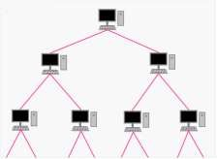
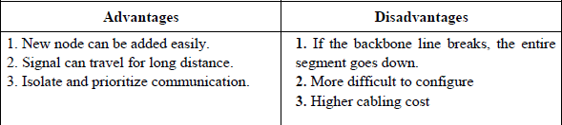
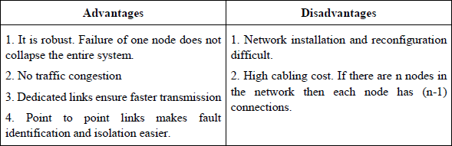
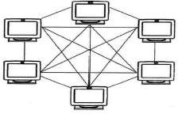
NETWORK TOPOLOGY
TREE TOPOLOGY:
MESH TOPOLOGY:
S U R E S H
, 9787640719
Y E S
W E
C S

Slide 24
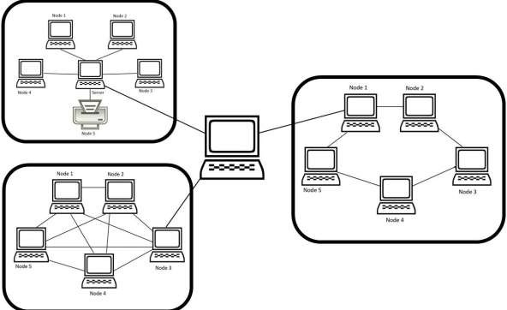
NETWORK TOPOLOGY
HYBRID TOPOLOGY:
- It is a combination of more than one topology
S U R E S H
, 9787640719
Y E S
W E
C S

Slide 25
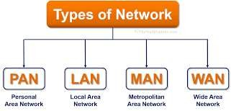
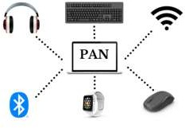
1.Personal Area Network (PAN)
For very small distance (10 METRES) like small room
communicationbetweentwo-threemobiledevicesorPCforpersonalpurpose.
Private Communication
Example: Bluetooth
S U R E S H
, 9787640719
Y E S
W E
C S

Slide 26
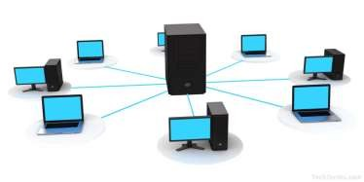
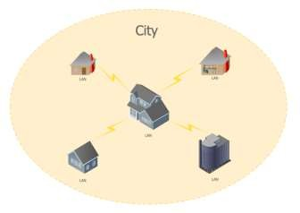
NETWORK TYPES
Local Area Network(LAN)–limited area (within building)
  Use in small local area, like in an institute or an organization.
  Devices are connected via physical medium.
  Limited distance, up to 1KM
  Example – Intranet
Metropolitan Area Network(MAN)–within city
  Larger than LAN.
  Used in Metropolitan cities.
  Range up to 50 KM radius.
S U R E S H
, 9787640719
Y E S
W E
C S

Slide 27

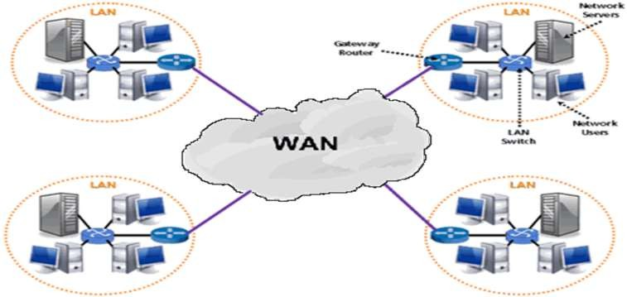
NETWORK TYPES
Wide Area Network(WAN)
  Within multiple city/state/countries
  Large network
  Public
  Example – Internet
S U R E S H
, 9787640719
Y E S
W E
C S

Slide 28
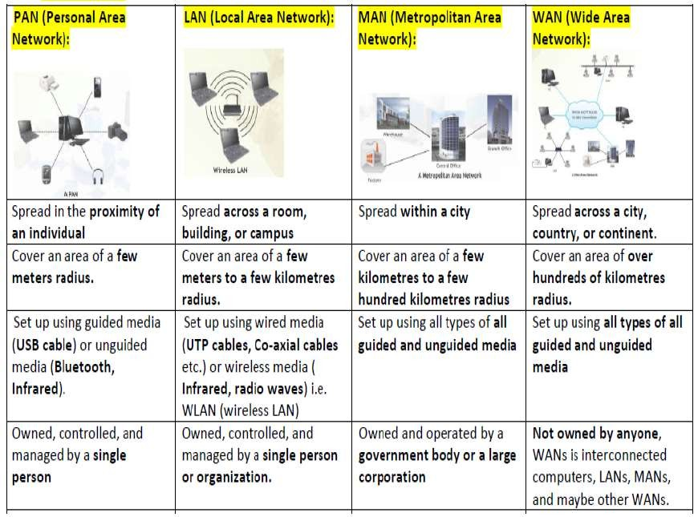
NETWORK TYPES
S U R E S H
, 9787640719
Y E S
W E
C S

Slide 29
CASE STUDY BASED QUESTIONS
Things to remember before solving
1 |  | Install the SERVER in the block which has most number of computers
2 |  | Draw the LAYOUT for efficient connection -Draw all the possible LAYOUTS by using BUS and STAR topology and SELECT THE LAYOUT WHICH HAS LOWEST DISTANCE
3 | a | Place the HUB/SWITCH – to connect all the computers within the block/building
 | b | Place the ROUTER – to connect all the computers between two blocks/buildings
4 |  | PLACING THE REPEATER
 | a | If you using TWISTER PAIR CABLE – use REPEATER for above 100 meters
 | b | If you using COAXIAL CABLE – use REPEATER for above 500 meters (ESPECIALLY , THINNET – 185METERS and THICKNET – 500 METERS)
 | c | If you using FIBER OPTIC CABLE – use REPEATER for above 80 KMS
S U R E S H
, 9787640719
Y E S
W E
C S

Slide 30
CASE STUDY BASED QUESTIONS
Things to remember before solving
5 | PLACING THE MODEM – in which block has maximum number of computers
6 | SELECTING THE TRANSMISSION MEDIA Media for longer distance – SATELLITE LINK Media for Hilly areas – RADIO WAVE Economic wireless connection – RADIOWAVE / MICROWAVE Best Wired media – Optical fiber
7 | FIREWALL – for data protection and data security
8 | CHOOSING THE INTERNET CONNECTION For ECONOMIC internet connection – DIALUP INTERNET CONNECTION For FASTER internet connection – BROADBAND INTERNET CONNECTION
9 | TYPE OF NETWORK PAN – MAX. 10 METERS LAN – MAX. 1KM MAN – MAX. 100KMS WAN – WORLD WIDE (CITY/STATE/COUNTRY/CONTINENT)
S U R E S H
, 9787640719
Y E S
W E
C S

Slide 31



N E TWOR K PROTOCOL S
HTTP
PPP
SMTP
FTP
VoIP
POP3
TCP/IP
TELNET
HTTPS
GSM
GPRS
WLL
S U R E S H
, 9787640719
Y E S
W E
C S

Slide 32












ABBREVIATIONS
PROTOCOL | FULL FORM
H T T P | HYPER TEXT TRANSFER PROTOCOL
F T P | FILE TRANSFER PROTOCOL
TC P/ I P | TRANSMISSION CONTROL PROTOCOL INTERNET PROTOCOL
PPP | POINT TO POINT PROTOCOL
Vo I P | VOICE OVER INTERNET PROTOCOL
T E L N E T | TERMINAL NETWORK
I P v 4 | INTERNET PROTOCOL VERSION 4
I P v 6 | INTERNET PROTOCOL VERSION 6
S U R E S H
, 9787640719
Y E S
W E
C S

Slide 33















ABBREVIATIONS
PROTOCOL | FULL FORM
S M T P | SIMPLE MAIL TRANSFER PROTOCOL
P O P 3 | POST OFFICE PROTOCOL 3RD VERSION
H T T P S | HYPER TEXT TRANSFER PROTOCOL SECURE
G S M | GLOBAL SYSTEM FOR MOBILE COMMUNICATION
G P RS | GENERAL PACKET RADIO SERVICE
W L L | WIRELESS LOCAL LOOP
W i F i | WIRELESS FIDELITY
W i M A X | WORLDWIDE INTEROPERABILITY FOR MICROWAVE ACCESS
S U R E S H
, 9787640719
Y E S
W E
C S

Slide 34
NETWORK PROTOCOLS
Established set of rules that determine how data is transmitted between different devices in the same network
Rules that are applicable for network
S U R E S H
, 9787640719
Y E S
W E
C S

Slide 35



HTTP - HYPER TEXT TRANSFER PROTOCOL
It is a request-response protocol, HTTP gives users a way to interact with web resources such as HTML files by transmitting hypertext messages between clients and servers.
HTTP clients generally use Transmission Control Protocol (TCP) connections to communicate with servers.
It is used for transfer all files and other data from one computer to other computer on WWW.
It is used to access websites on the Internet.
S U R E S H
, 9787640719
Y E S
W E
C S

Slide 36


HTTPS
HYPER TEXT TRANSFER PROTOCOL SECURE
It is a combination of the Hypertext Transfer Protocol (HTTP) with the Secure Socket Layer (SSL)/Transport Layer Security (TLS) protocol.
SSL works by using a public key to encrypt data transferred over the SSL connection.
HTTPS adds encryption, authentication, and integrity to the HTTP protocol.
S U R E S H
, 9787640719
Y E S
W E
C S

Slide 37
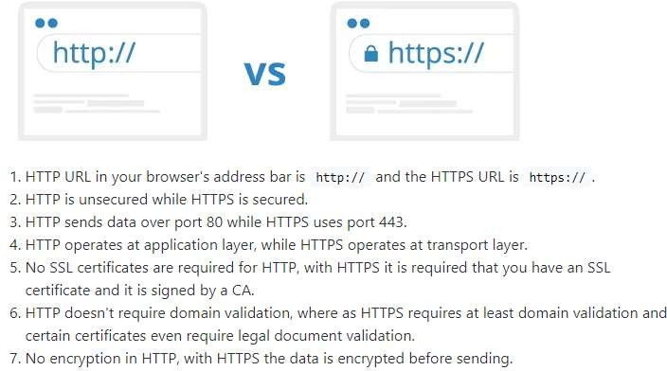
VS HTTPS
HTTP
S U R E S H
, 9787640719
Y E S
W E
C S

Slide 38



IPv4 – INTERNET PROTOCOL version 4
An IPv4 address is a series of four eight-bit binary numbers separated by a decimal point.
Although you may use any numbering system to represent a unique 32-bit number.
Most commonly you see IP addresses expressed in dot-decimal notation.
Example- 192.0.2.126
S U R E S H
, 9787640719
Y E S
W E
C S

Slide 39


IPv6 – INTERNET PROTOCOL version 6
An IPv6 address is 128 bits in length and consists of eight, 16-bit fields, with each field bounded by a colon.
Each field must contain a hexadecimal number, in contrast to the dotted-decimal notation of IPv4 addresses.
EXAMPLE :
2001:db8:3333:4444:5555:6666:7777:8888
S U R E S H
, 9787640719
Y E S
W E
C S

Slide 40

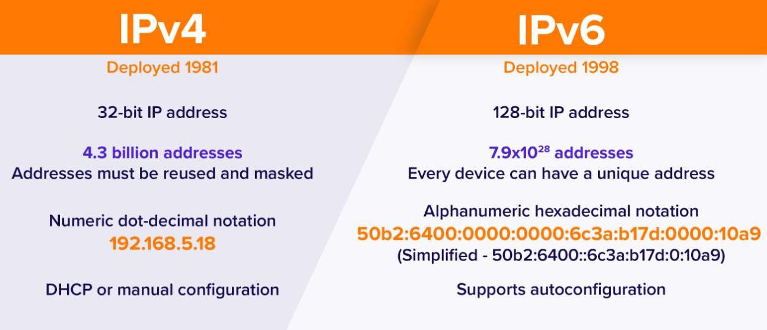
VS IPv6
IPv4
S U R E S H
, 9787640719
Y E S
W E
C S

Slide 41






TCP/IP – TRANSMISSION CONTROL PROTOCOL INTERNET PROTOCOL
It is a set of protocols that define how two or more computers can communicate with each other.
The protocol is effectively a set of rules that describe how the data is passed between the computers.
TCP – is responsible for verifying the correct delivery of data from client to server.
IP – is responsible for moving packets from node to node.
S U R E S H
, 9787640719
Y E S
W E
C S

Slide 42


FTP – FILE TRANSFER PROTOCOL
Simplest and most secure way to exchange files over Internet.
If you send files using FTP, files are either uploaded or downloaded to the FTP server.
When you're uploading files, the files are transferred from a personal computer to the server.
When you're downloading files, the files are transferred from the server to your personal computer.
S U R E S H
, 9787640719
Y E S
W E
C S

Slide 43


PPP – POINT to POINT PROTOCOL
It transmits multi protocol data between two directly connected point to point computers.
It is byte oriented protocol.
It is widely used in broadband communication.
S U R E S H
, 9787640719
Y E S
W E
C S

Slide 44


TELNET – TERMINAL NETWORK
Telnet is a protocol that allows you to connect to remote computers (called hosts) over a TCP/IP network.
Using telnet client software on your computer, you can make a connection to a telnet server.
An admin or other user can access someone’s computer remotely.
You login as a regular user with all privileges.
S U R E S H
, 9787640719
Y E S
W E
C S

Slide 45


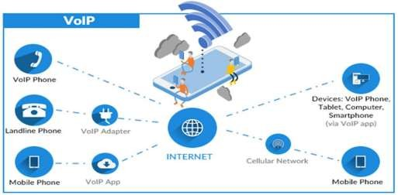
VOiP – VOICE OVER INTERNET PROTOCOL
VoIP is the technology that converts your voice into a digital signal, allowing you to make a call directly from a computer, a VoIP phone, or other data-driven devices.
Simply put, it's phone service delivered over the internet.
S U R E S H
, 9787640719
Y E S
W E
C S

Slide 46


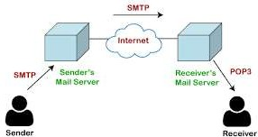
SMTP
SIMPLE MAIL TRANSFER PROTOCOL
SMTP is a set of communication guidelines that allow software to transmit an electronic mail over the internet.
It is a program used for sending messages to other computer users based on e-mail addresses.
S U R E S H
, 9787640719
Y E S
W E
C S

Slide 47





RD
POP3 – POST OFFICE PROTOCOL 3 VERSION
It is the most recent version of a standard protocol for receiving e-mail.
POP3 is a client/server protocol in which e-mail is received and held for you by your Internet server.
It allows you to download the received messages on local machine, so that you can read even offline.
S U R E S H
, 9787640719
Y E S
W E
C S

Slide 48


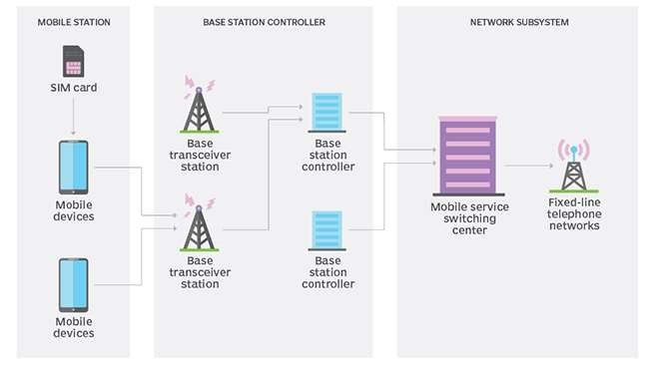
GSM
GLOBAL SYSTEM FOR MOBILE COMMUNICATION
It is a digital cellular technology used for transmitting mobile voice and data services.
GSM technology was developed as a digital system using the time division multiple access (TDMA) technique for communication purposes.
S U R E S H
, 9787640719
Y E S
W E
C S

Slide 49



GPRS - GENERAL PACKET RADIO SERVICE
It is a packet oriented mobile data standard on the 2G and 3G cellular communication network's GSM.
It provides moderate-speed data transfer, by using unused time division multiple access (TDMA) channels in, for example, the GSM system.
GPRS is used for video calling, Email accessing, multimedia messaging etc.
S U R E S H
, 9787640719
Y E S
W E
C S

Slide 50



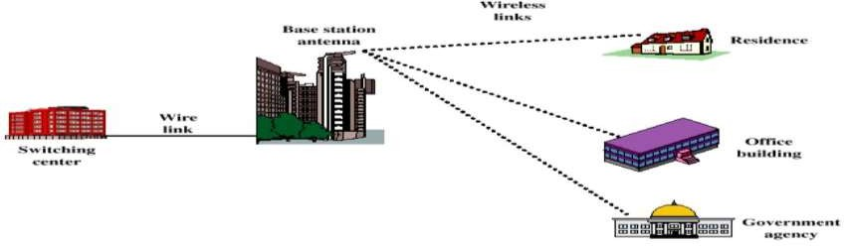
WLL – WIRELESS LOCAL LOOP
Wireless local
loop (WLL), is the use of
a wireless
communications link as the "last mile /
first mile"
connection for delivering plain old telephone service (POTS) or Internet access to telecommunications customers.
Simply means that the subscriber is connected to the nearest exchange through a radio link instead of through these copper wires.
S U R E S H
, 9787640719
Y E S
W E
C S

Slide 51



WiFi – WIRELESS FIDELITY
Wi-Fi is a family of wireless network protocols, based on the IEEE 802.11 family of standards,
These are commonly used for local area networking of devices and Internet access, allowing nearby digital devices to exchange data by radio waves.
It is an underlying technology of wireless local area network (WLAN).
Wi-Fi allows computers and other devices to communicate over a wireless network.
S U R E S H
, 9787640719
Y E S
W E
C S

Slide 52



WiMAX – WORLDWIDE INTEROPERABILITY FOR MICROWAVE ACCESS
While a Wi-Fi signal can cover a radius of several 100 feet, a fixed WiMAX station can cover a range of up to 30 miles.
it will potentially be used to provide wireless Internet access to entire cities and other large areas
S U R E S H
, 9787640719
Y E S
W E
C S

Slide 53
WiFi VS WiMAX
WiFi | WiMAX
Launched in the year 1997 | Launched in the year 2004
Under IEEE 802.11 x standards | Under IEEE 802.16 y standards
It covers range upto 100meters | It covers range upto 80-90kms
It can transfer data at 54mbps speed | It can transfer data at 40mbps speed
It is not connection oriented | It is connection oriented
It is short range technology | It is long range technology
Mainly used for home or corporate purpose | It provides internet for whole city.
It used in LAN applications | It used in MAN applications
S U R E S H
, 9787640719
Y E S
W E
C S

Slide 54
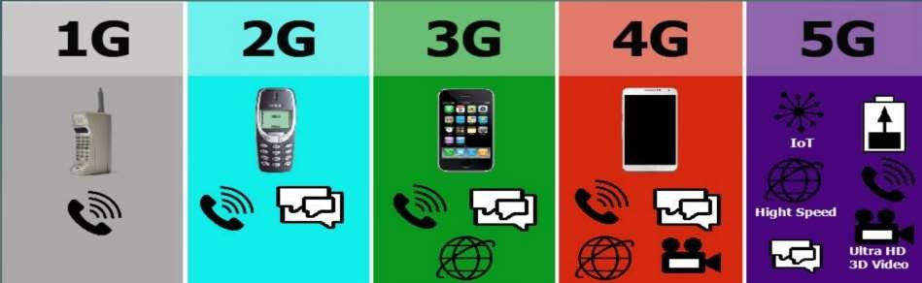
MOBILE COMMUNICATION TECHNOLOGIES
Mobile technology is technology that goes where the user goes.
It consists of portable two-way communications devices, computing
devices and the networking technology that connects them.
They enable mobile devices to share voice, data and applications (mobile apps).
MOBILE TECHNOLOGY - GENERATIONS
S U R E S H
, 9787640719
Y E S
W E
C S

Slide 55






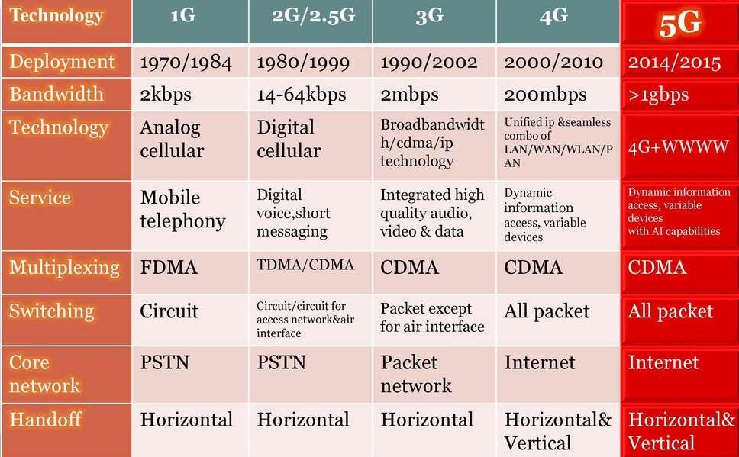
1G vs 2G vs 3G vs 4G vs 5G
S U R E S H
, 9787640719
Y E S
W E
C S

Slide 56
WEB SERVICES
WWW
U R L
D N S
D H T M L
X M L
H T M L
W E B
S E R V E R
W E B P A G E
W E B S I T E
W E B
B R O W S E R
W E B
H O S T I N G
S U R E S H
, 9787640719
Y E S
W E
C S

Slide 57










ABBREVIATIONS
PROTOCOL | FULL FORM
WWW | WORLD WIDE WEB
URL | UNIFORM RESOURCE LOCATOR
D N S | DOMAIN NAME SYSTEM
H T M L | HYPER TEXT MARKUP LANGUAGE
D H T ML | DYNAMIC HYPER TEXT MARKUP LANGUAGE
X ML | EXTENSIBLE MARKUP LANGUAGE
S U R E S H
, 9787640719
Y E S
W E
C S

Slide 58
WEB SERVICES
Web service-is a standardized medium, protocol or language to propagate communication between the client and server applications on the World Wide Web.
A web service is a software module that is designed to perform a certain set of tasks.
Web services are invoked by the user directly or indirectly to provide services to the program/software which is being used as a part of WWW.
S U R E S H
, 9787640719
Y E S
W E
C S

Slide 59
WWW and INTERNET
Collection of linked documents or pages stored on million of computers and distributed across internet.
Many people think that the internet and the world wide web (WWW) are the same thing. While they are closely linked, they are very different systems.
The internet is a huge network of computers all connected together.
The world wide web (‘www’ or ‘web’ for short) is a collection of web pages found on this network of computers.
S U R E S H
, 9787640719
Y E S
W E
C S

Slide 60


WEB BROWSER AND WEB SERVER
Web Browser is a software which is used to browse and display pages
available over internet.
Ex: Internet Explorer, Firefox, Google chrome.
Web server is a software which provides these documents when requested by web browsers.
A web browser sends request to server for web based documents and services.
S U R E S H
, 9787640719
Y E S
W E
C S

Slide 61
WEB PAGE
AND WEBSITE
Web page – A html document which can be displayed in a web browser.
Website – A collection of web pages which are grouped together and usually connected together in various ways. Often called a “website” or simply a “site”.
Home page – First page of the website.
Web portal – website that hosts other websites. Ex: google.com , yahoo.com
S U R E S H
, 9787640719
Y E S
W E
C S

Slide 62

URL – UNIFORM RESOURCE LOCATOR
Uniform Resource Locator is defined as the global address of documents and other resources on the World Wide Web.
The URL is an address that sends users to a specific resource online, such as a webpage, video or other document or resource.
S U R E S H
, 9787640719
Y E S
W E
C S

Slide 63


DNS – DOMAIN NAME SYSTEM
The Domain Name System, translates human readable domain names (for example, www.cbse.nic.in) to machine readable IP addresses (for example,182.156.84.26).
DNS servers translate requests for names into IP addresses.
Domain name is our website name.
S U R E S H
, 9787640719
Y E S
W E
C S

Slide 64

HTML - HYPER TEXT MARKUP LANGUAGE
Web document written in special language.
It tells browser that how data to be displayed.
It provide various kinds of tags (commands) used to define the structure and appearance of web page.
S U R E S H
, 9787640719
Y E S
W E
C S

Slide 65
XML – EXTENSIBLE MARKUP LANGUAGE
It is a language for defining a structured information.
We can create our own tags.
It defines a set of rules for encoding documents in a format that is both human-readable and machine-readable.
XML is Platform Independent and Language Independent.
S U R E S H
, 9787640719
Y E S
W E
C S

Slide 66

XML VS HTML
S U R E S H
, 9787640719
Y E S
W E
C S

Slide 67

WEB HOSTING
Web hosting is the place where all the files of your website live.
It is like the home of our website where it actually lives.
Four types of web hosting:
FREE HOSTING
VIRTUAL or SHARED HOSTING
DEDICATED HOSTING
CO-LOCATION HOSTING
S U R E S H
, 9787640719
Y E S
W E
C S

Slide 68


TO DOWNLOAD
QUESTION BANK FOR COMPUTER NETWORKS JOIN THE TELEGRAM GROUP
PSB TERM-2 CBSE CS
S U R E S H
, 9787640719
Y E S
W E
C S

Slide 69

THANK YOU
STUDENTS
ANY QUERIES
ASK ME IN THE TELEGRAM GROUP
(@cbsecspsb)
or
DIRECTLY CONTACT ME
9787640719
S U R E S H
P
PYTHON &
SQL
EXPERT

